Slide 1
The Simple Linear Regression Model:
Specification and Estimation
Part 2
BUAN / MECO 6312
Dr. Moran Blueshtein
University of Texas - Dallas

Slide 2
Estimating the Regression Parameters

Slide 3
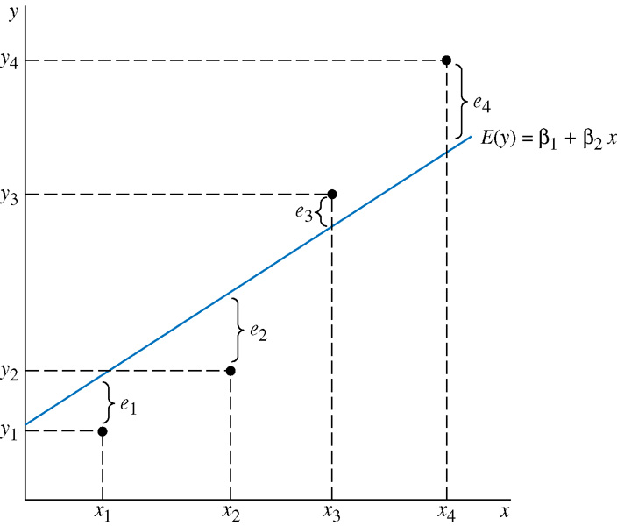
An Econometric Model
The relationship among y, e and the true regression line

Slide 4
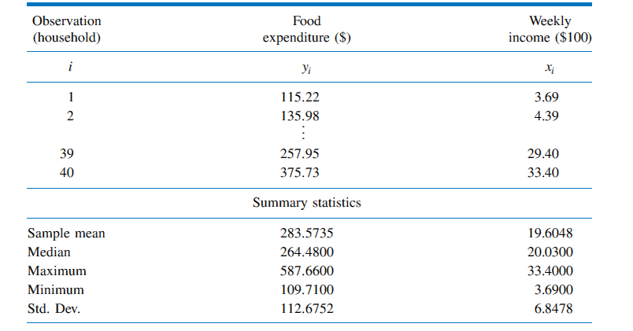
Estimating the Regression Parameters
Expenditure and Income Data

Slide 5
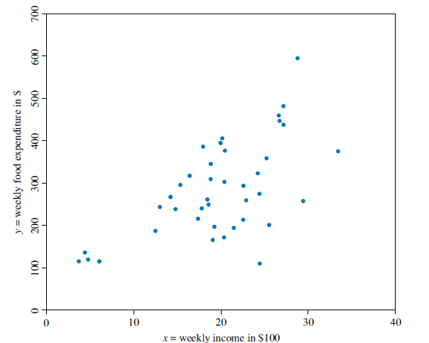
Estimating the Regression Parameters
Data on food expenditure and income

Slide 6
Estimating the Regression Parameters
The Least Squares Principle
The fitted regression line is:
The least squares residual is:

Slide 7
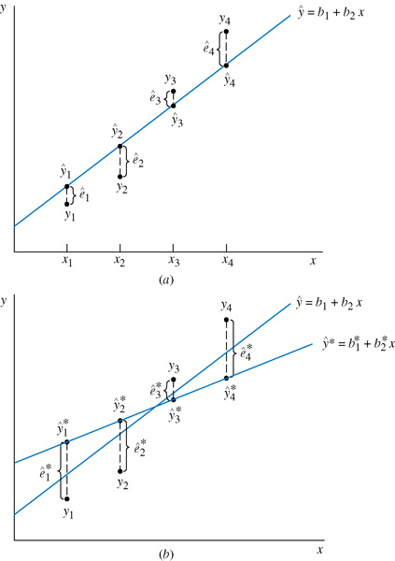
Estimating the Regression Parameters
The relationship among y, ê and the fitted regression line
The Least Squares Principle

Slide 8
Estimating the Regression Parameters
The Least Squares Principle
Least Squares estimators for the unknown parameters β₁ and β₂ are obtained my minimizing the sum of squared errors:

Slide 9
Estimating the Regression Parameters
The Least Squares Principle
Suppose we have another fitted line:
The least squares line has the smaller sum of squared residuals:

Slide 10
Derivation of the Least Squares Estimates
Set the derivatives equal to zero to get 2 eqs:

Slide 11
Estimating the Regression Parameters
THE LEAST SQUARES ESTIMATORS
The Least Squares Principle
We call b₁ and b₂ the least squares estimators (OLS).
What is the meaning of these formulas?

Slide 12
Estimating the Regression Parameters
Interpreting the Estimates
Given a specific sample we can now derive our least squares estimates
A convenient way to report the values for b₁ and b₂ is to write out the estimated or fitted regression line:

Slide 13
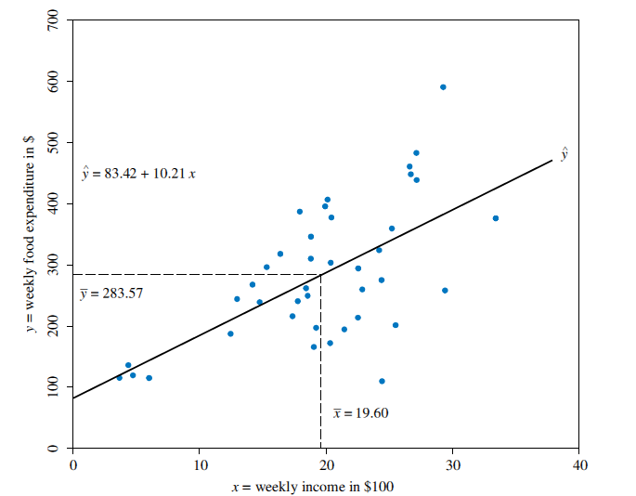
Estimating the Regression Parameters
The fitted regression line
Estimates for the Food Expenditure Function

Slide 14
Estimating the Regression Parameters
Interpreting the Estimates
The value b₂ = 10.21, thus, we estimate that if income goes up by $100, expected weekly expenditure on food will increase by approximately $10.21
the intercept estimate b₁ = 83.42 is an estimate of the weekly food expenditure on food for a household with zero income.

Slide 15
Estimating the Regression Parameters
Regression Output
Computer Output

Slide 16
Estimating the Regression Parameters
Prediction
Suppose that we wanted to predict weekly food expenditure for a household with a weekly income of $2000. This prediction is carried out by substituting x = 20 into our estimated equation to obtain:
We predict that a household with a weekly income of $2000 will spend on average $287.61 per week on food

Slide 17
Estimating the Regression Parameters
Elasticities
Income elasticity is a useful way to characterize the responsiveness of consumer expenditure to changes in income. The elasticity of a variable y with respect to another variable x is:

Slide 18
Estimating the Regression Parameters
Elasticities
We typically calculate the elasticity at the “point of the means” because it is a representative point on the regression line.
We estimate that a 1% increase in weekly household income will lead on average to a 0.71% increase in weekly household expenditure on food.

